Slide 1
FHIR for Implementers
Lantana CDA Academy
Notes:
I made the module name larger (36 pt) and bold
Text throughout uses Franklin Gothic Book, bold

Slide 2

Interoperability:
Making it Real!
Developed by:
Lantana Consulting Group
Notes:
Credit slide .. Number 2 on all

Slide 3
CDA, CCD, FHIR, HL7, and Health Level Seven are registered trademarks of Health Level Seven International Registered in US Patent and Trademark Office

Slide 4
Overview
Introduction to FHIR
About REST & Resources
The FHIR Framework
Implementation
CCDA & FHIR

Slide 5
About me
Consultant in Healthcare Integration
Wrote a v2 messaging integration engine
Worked as lead developer for a Diagnostics ISV
Past co-chair of the Structured Document committee
CDA Lead for the Australian National EHR
Design and publication of CDA specifications
Architecture & Security for the system
Implementation support for all parties
Guide the conformance process

Slide 6
Introduction to FHIR

Slide 7
FHIR
F – Fast (to design & to implement)
Relative – No technology can make integration as fast as we’d like
H – Health
Area of focus for HL7
I – Interoperable
Purpose of HL7
R – Resources
Building blocks – more on these to follow

Slide 8
Genesis of FHIR
Has been a need to share healthcare information electronically for a long time
HL7 v2 is ~25 years old
Increasing pressure to broaden scope of sharing
Across organizations, disciplines, even borders
Regional and National programs
Mobile & cloud-based applications
Faster – integration in days or weeks, not months or years
Notes:
Who

Slide 9
Genesis of FHIR
What did HL7 have to offer in this space?
Unsatisfactory
V3 attempted to address some of these issues, but too slow and too hard
CDA has had the most success, but too hard for implementers, and not flexible
Different contexts of interoperability → different representations that aren’t compatible
Nothing suitable for light-weight integration, or for Health 2.0

Slide 10

Genesis of FHIR
HL7 undertook a “Fresh look”
What would healthcare exchange look like if we started from scratch using modern approaches?
Web search for success markers led to RESTful based APIs
Exemplar: Highrise (https://github.com/37signals/highrise-api)
Drafted a healthcare exchange API based on this approach
This turned into the FHIR specification

Slide 11
FHIR Development Progress
July 2011 – Conception
Aug/Sept 2012 – First Draft Ballot
Sept 2012 – First Connectathon
Aug/Sept 2013 (now) – First DSTU ballot DSTU = Draft Standard For Trial Use
January 2014 – DSTU finalised
~Mar 2015 – 2nd DSTU
Mid 2016? – Normative Version

Slide 12
FHIR Manifesto
Focus on Implementers
Leverage cross-industry web technologies
Target support for common scenarios
Require human readability as base level of interoperability
Support multiple paradigms & architectures
Make content freely available
Demonstrate best practice governance
Notes:
We don’t actually have a formal manifesto, but these are the principles we adhere to.

Slide 13
Implementer Focus
Specification is written for one target audience: implementers
Rationale, modeling approaches, etc. kept elsewhere
Multiple reference implementations from day 1
Publicly available test servers
Starter Implementations published with spec
Java, C#, ObjectiveC, Pascal, Javascript, XSLT…
Connectathons to verify specification approaches
Instances you can read and understand ☺
Lots of examples (and they’re valid too)
using HL7.Fhir.Instance.Model;
using HL7.Fhir.Instance.Parsers;
using HL7.Fhir.Instance.Support;
XmlReader xr = XmlReader.Create(
new StreamRead
IFhirReader r = new XmlFhirReader
// JsonTextReader jr = new JsonTe
// new StreamRead
// IFhirReader r = new JsonFhirRe
ErrorList errors = new ErrorList(
LabReport rep = (LabReport)Resour
Assert.IsTrue(errors.Count() == 0
Notes:
Who’s read the v3 spec? – modeler & balloter focused
Spec is driven by people who write code
Numerous pieces have been changed because of experience with what worked when trying to implement
Even have a test workbench for RESTful servers

Slide 14
Support “Common” Scenarios
Focus on scenarios that implementers ask for
Inclusion of content in core specification is based on core content rule
“We only include data elements if we are confident that most normal implementations using that resource will make use of the element”
Other content pushed to extensions
(more on this later)
Easy to say, governance challenge to achieve
Resources are simple and easy to understand and use
Notes:
Design by constraint failed – years to develop, what was produced required yet more design to be implementable and after that might not be interoperable
How to determine the 80%? Look to existing specs – v2, v3, CDA templates, OpenEHR, jurisdictional projects, what implementations we’ve seen
If not sure, err on the side of “not in for now”
Note: not 80% of instances, 80% of implementations
Challenges with “raising the bar”
What happens when there aren’t many/any implementations?

Slide 15
Web technologies
Data types aligned with common web approaches
Instances shared using XML & JSON
Collections represented using ATOM
Same technology that gives you your daily news summary
Out-of-the-box publish/subscribe
Web calls work the same way they do for Facebook, Twitter etc
Rely on HTTPS, OAuth, etc. for security functions
Skills & Libraries are easily available
RESTful API is re-usable
Notes:
We try very hard to *not* invent stuff that exists elsewhere unless it’s really broken or totally unaligned with the FHIR principles.

Slide 16

Human Readable
CDA taught HL7 a very important lesson
Even if the computers don’t understand 99% of what you’re sending, that’s ok if they can properly render it to a human clinician
This doesn’t just hold for documents – important for messages, services, etc.
In FHIR, every resource is has a human-readable expression
Can be direct rendering or human entered
Notes:
Even when you think your target will understand all the encoded data, reality is data often gets shared beyond the originally intended context
Allow for exceptions for things like automated device readings, etc.

Slide 17
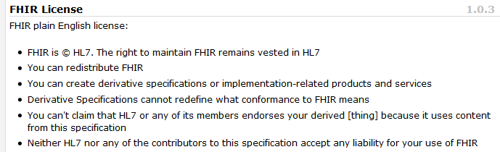
Freely available
Unencumbered – free for use, no membership required
http://hl7.org/fhir
Notes:
Was a bigger deal before HL7 decided to open up all IP
full legal text towards bottom of FHIR home page

Slide 18
FHIR & Cost of Integration
These factors will drive down the cost of integration and interoperability
Easier to Develop
Easier to Troubleshoot
Easier to Leverage in production
More people to do the work (less expensive consultants)
Competing approaches will have to match the cost, or disappear – effect is already being felt

Slide 19
Future impact of FHIR
Impact of FHIR on the market:
Drive interoperability prices down
Higher Expectations
Increased spend on integration (N x 2!)
Overall Market focus
PHR on the web
Healthcare repositories (MHD+)
Device Data management
Retooling existing connections

Slide 20
About REST and Resources

Slide 21
REST
“Representational state transfer” – an architecture for how to connect systems
Outcomes
Simple stable interfaces
High Performance / Scalability
Visible Process (e.g. can debug)
Portability
Reliability (resistance to failure)

Slide 22
REST in practice
“Resources” with an explicit and stable URI
The name for what gets exchanged in REST
Defined behaviour and meaning
Known identity / location
Quite an abstract idea
Formats: XML / JSON / RDF
Exchange using HTTP
Security: SSL / OAuth
Very often “REST” is only followed loosely, hence “RESTful”

Slide 23
REST Operations
CRUD(E):
Create – create a new instance of data
Read – get the content (state) of an instance of data
Update – change the content of an instance of data
Delete – remove the instance of data
Execute – get the instance of data (?) to do something for you

Slide 24
RPC vs REST
RPC (Remote Procedure Call):
Ask a server to perform some operation
Hand it a set of parameters
Server performs some operations
Returns a set of parameters
REST:
Define a URI that represents the state of something
Tell the server what the state should be
Server makes the state change happen

Slide 25
RPC vs REST example
Example:
A device that monitors a patient %0₂ saturation
Raises an alarm on EHR if it’s too low
EHR can turn the alarm off
RPC:
POST http://acme.org/devices/turnOffAlarm
Parameters: device id, alarm id
REST:
POST http://acme.org/devices/[deviceid]/[alarmid]
Content: data to say “Alarm is off”

Slide 26
RPC vs REST
Difference is subtle, and depends on perspective
Outcome is large difference
REST is increasingly preferred in practice
Most systems mix and match
“mini-operations”
General issue: REST doesn’t deal well if server needs context from the client
Needed for poorly trusted clients

Slide 27
REST Formats
XML
JSON
RDF
Atom

Slide 28
JSON
{
"Image": {
"Width": 800,
"Height": 600,
"Title": "View from 15th Floor",
"Thumbnail": {
"Url": "http://www.example.com/image/481989943",
"Height": 125,
"Width": 100
},
"Animated" : false,
"IDs": [116, 943, 234, 38793]
}
}

Slide 29
JSON Types
Type | Description
String | A sequence of characters with surrounded by "". See below for escaping rules
Number | A number, written in decimal (23.4) or exponential notation (2.34e1)
Array | A sequence of values, surrounded by [] and separated by “,”. Note that the values do not need to be the same type, though they usually are
Object | A sequence of properties, surrounded by {}. Each property has a string name and a value separated by a “:”, and properties are separated by a “,”
Literal Name | One of the three special values null, true, or false.

Slide 30
XML vs JSON
XML | JSON
Supports many character sets and encoding | Supports only Unicode, using a UTF encoding (usually UTF-8)
Has both elements and attributes | Only has properties
Elements can have a mix of text and child elements | Properties can only have a single value
Element names can be namespaced | No namespacing system for property names
It can be ambiguous whether whitespace matters or not | The meaning of whitespace is never ambiguous (it matters in string values, and doesn’t matter elsewhere)
Elements can repeat | Repeating values are represented explicitly with an Array

Slide 31
Converting between JSON & XML
What to do about namespaces
What to do about attributes in the XML
What to do about element text, and mixed content
The problem of Arrays
<Concept xmlns="http://test.org">
<name>Example</name>
<ID>116</ID>
<ID>943</ID>
<ID>234</ID>
<ID>38793</ID>
<text xmlns="http://w3.org/xhtml">
This is some text that is
<span style="font-style: bold”>bold</span>. </text>
</Concept>
Notes:
Exercise: convert this to JSON

Slide 32
Atom
Atom Syndication Format is an XML language used for ”web feeds”
A static representation (e.g. a document) of a set of HTTP requests
Allows applications to exchange batches of resources while retaining their context
“Feed”
title / date / uri for whole feed / links / categories
Entries
Title / date / uri for entry / links / categories
Actual content of the entry (e.g. a resource)

Slide 33
Atom Example
<feed xmlns="http://www.w3.org/2005/Atom">
<title>Example ACME Blog</title>
<id>urn:uuid:1c4faa4a-7f8c-4d7f-b976-852829010a7d</id>
<link rel="self" href="http://acme.org/blog"/>
<updated>2014-05-11T10:24:00-05:00</updated>
<entry>
<title>ACME: Still the best</title>
<id>http://acme.org/blog/23</id>
<link rel="self" href="http://acme.org/blog/23?v=2"/>
<updated>2014-05-11T10:23:50-05:00</updated>
<content type="text/xml">
<Claim xmlns="http://standards.org/ego-claim">
<text>ACME really still is the best</text>
</Claim>
</content>
</entry>
</feed>

Slide 34
FHIR Resources
Administrative
Patient, Practitioner, Organization, Location, Coverage, Invoice
Clinical Concepts
Allergy, Condition, Family History, Care Plan
Infrastructure
Document, Message, Profile, Conformance

Slide 35
Business Operations in FHIR
Register a patient:
Create a Patient Resource
Admit a patient:
Create an Encounter Resource
Move a patient from one bed to another
Find and update the encounter resource
Prepare a list of medications to administer
Search through the medication prescriptions for a patient (and then apply logic)

Slide 36
FHIR Resource URLs
Template | Description | Example
[base] | Server URL | http://fhir.com
[base]/[type] | URL for type manager | http://fhir.com/Patient
[base]/[type]/[id] | URL for a resource | http://fhir.com/Patient/23
[base]/[type]/[id]/_history/[vid] | URL for a past version of a resource | http://fhir.com/Patient/23/_histroy/2

Slide 37
FHIR Operations - Instance
Op | Description | Request Content | Response Content
read | Read the current state of the resource | -- | Resource
vread | Read the state of a specific version of the resource (e.g. what it looked like in the past) | -- | Resource
update | Update an existing resource by its id (or create it if it is new). Use the resource representation supplied | Resource | --
delete | Remove the resource so it is no longer present (note: it still has a history) | -- | --
history | Get a list of all the past versions of the resource | -- | Atom feed

Slide 38
FHIR Operations - Type
Op | Description | Request Content | Response Content
create | Create a new resource with a server assigned id | Resource | --
search | Search through all resources of the type based on some filter criteria | Params | Atom Feed
history | Get a list of all the past versions of this resource type | -- | Atom Feed
validate | Check that the content would be acceptable as an update | Resource | Resource (OperationOutcome)

Slide 39
FHIR Operations - System
Op | Description | Request Content | Response Content
conformance | Get a conformance statement for the system | -- | Resource
transaction | Update, create or delete a set of resources as a single transaction | Atom Feed | Atom Feed
history | Retrieve the update history for all resources (full pub/sub) | -- | Atom Feed
search | Search through all resources of all types based on some filter criteria | Params | Atom Feeds

Slide 40
FHIR Operations Exercise
Use “Poster”
Server: http://fhir.healthintersections.com.au/open
Find a patient using search
Get the patient resource as XML
Update the patient’s date of birth
Get the patient resource as JSON and check changes
Get the patient history to see your change in the list

Slide 41
The FHIR Framework

Slide 42
Scope - Domains
Clinical Records
Medication Management
Diagnostic Ordering and Reporting
Device management & data collection
Appointments, Administration and Billing
Clinical Referrals
Decision Support
Security / Infrastructure

Slide 43
Scope - Contexts
Internet Web Portals
Social Web healthcare monitoring (Healthbook)
HIEs
National Health Records
Integration inside and between healthcare institutions
Internal Application APIs (plug-in extensibility)
Data exchange in secondary use applications

Slide 44
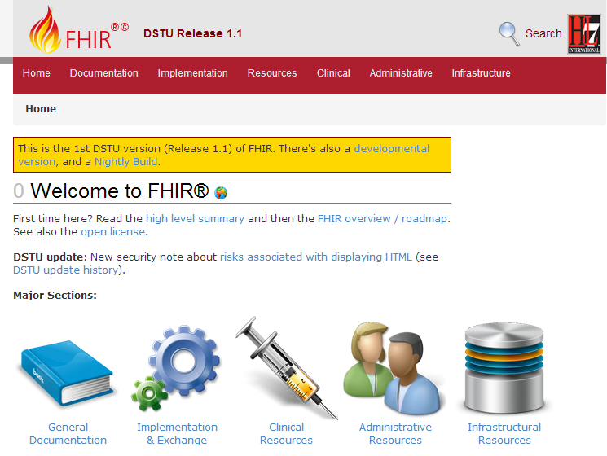
Guide to the Specification

Slide 45
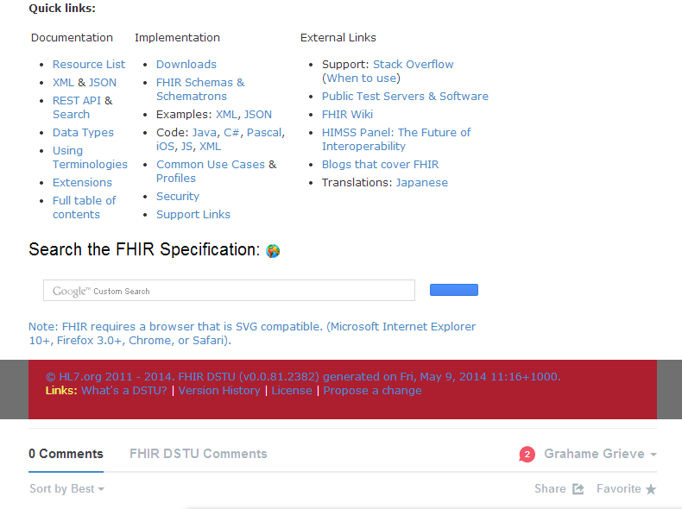
Guide to the Specification

Slide 46
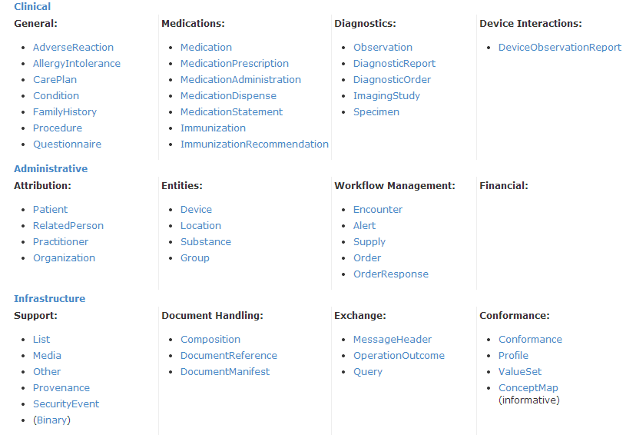
Guide to the Specification

Slide 47
Resource Documentation
For each Resource:
Scope and Usage Notes
Resource Content (UML and XML)
Terminology Bindings
Constraints
Implementation Issues
Search Parameters
Examples, Profiles, Formal Definitions
Mappings to RIM, CDA, v2, etc

Slide 48
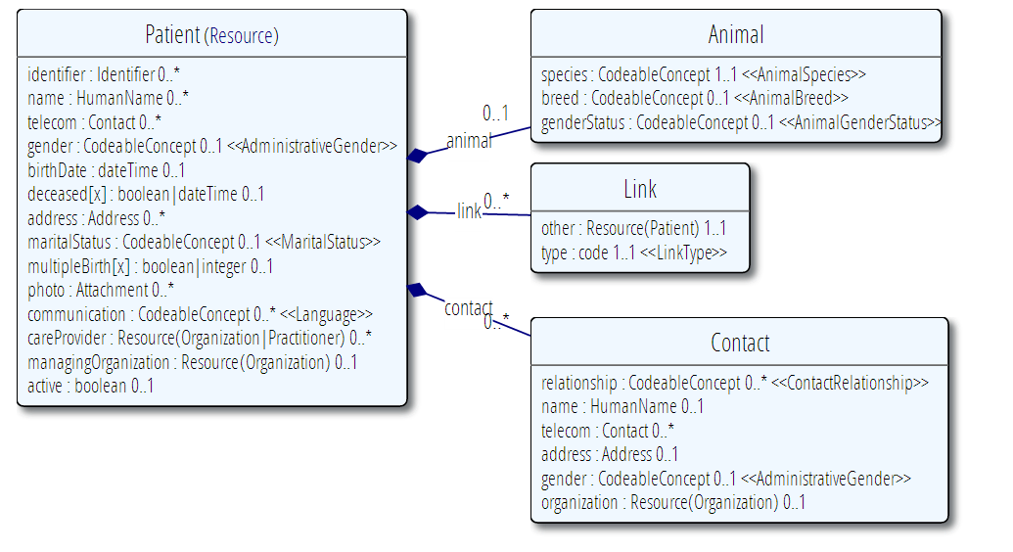
Example Resource Definitions

Slide 49
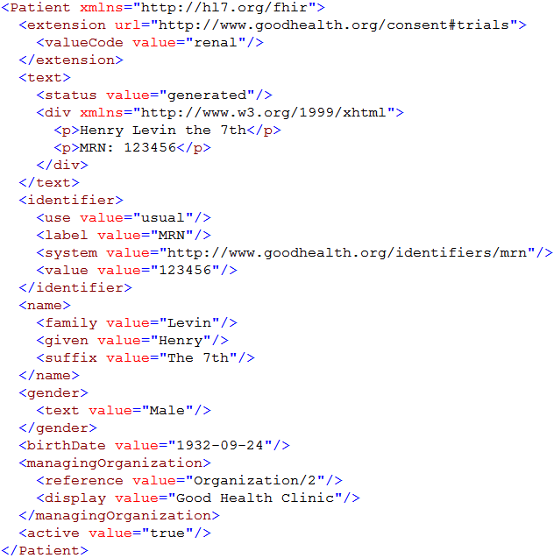
Extension with reference to its definition
Human Readable Summary
Standard Data Content:
MRN
Name
Gender
Date of Birth
Provider
Notes:
System for gender is wrong . . .

Slide 50
Resource elements
Resources are defined as an XML structure based on desired wire syntax
Hierarchy of elements
Each element has
Name
Either a datatype or nested elements
Cardinality
All collections are nested in a containing element
Definition
Coded Elements: Binding to Value Set

Slide 51
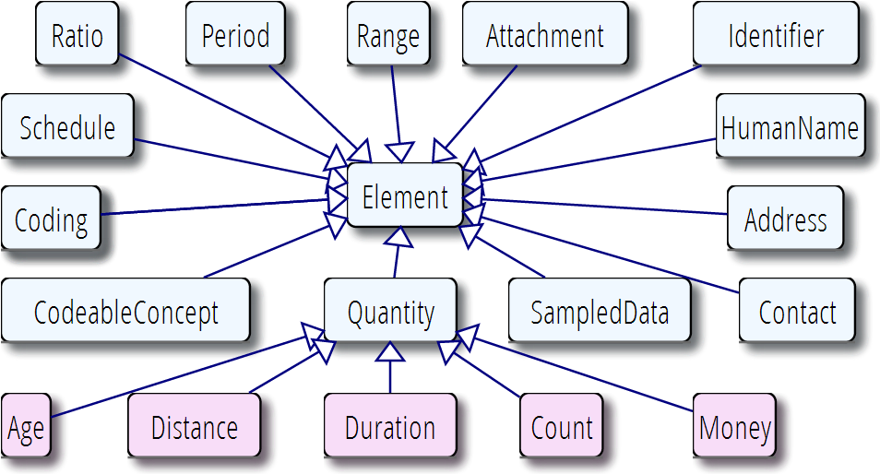
Data types

Slide 52
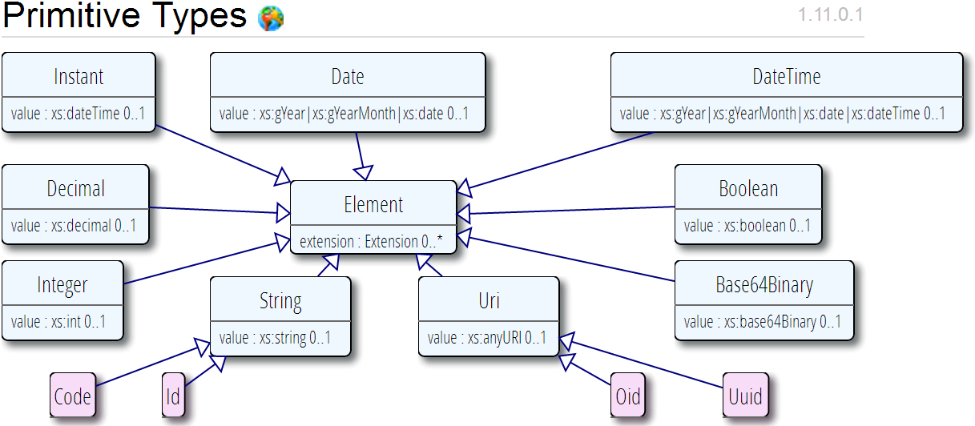
Primitive Data Types
Data Types map to primitives in most languages

Slide 53
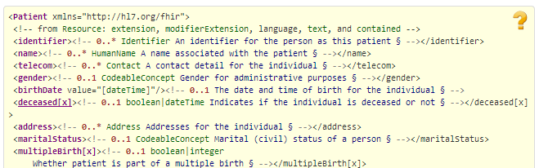
Building A Resource
Copy the XML fragment into an XML editor
Work through the elements filling in the data
Copy data type definition into place for complex data types
Exercise – build a patient resource

Slide 54
Patient Exercise
Mary Ann Maladie, Female, DOB = 05/13/1945
MRN = 3029290 at Good Health Hospital
Telephone number: (443) 455-4455
Address: 223 Longhorn Ave Sanford, IA, 99999
Patient passed away 04/26/2014
Next of Kin:
Sarah Petersen, (435) 555-1234

Slide 55
Differences to CDA
Slightly more information about the patient
Telephone number less restrictive
Most data types simpler (less tricks)
How identifiers work (URNs as well as OIDs)
Slightly different structure for codeable items
Identifier has more metadata

Slide 56
Extensions
FHIR has a standard framework for extensions
V2: Z-Segments
CDA: foreign namespaces
Every FHIR element can be extended
Every extension has:
Reference to a computable definition
Value – from a set of known types
Every system can read, write, store and exchange all legal extensions
All extensions are valid by schema etc

Slide 57
Governing Extensions
Any system can add extensions to a resource
That doesn’t make it a good idea – they’re only really useful if trading partners understand them
FHIR has a sliding scale governance for extensions
Local Projects
Domain standards (e.g Best Practice Cardiology)
National Standards (e.g. Standard Finnish Extensions)
HL7 published extensions (corner cases with international scope)

Slide 58
What’s the goal here?
In most areas of healthcare standards, there is wide variability
Between systems, countries, institutions, clinicians
Choices:
Specification only supports core – no one can use it
Specification adds everything – no one understands it
Specification picks winners – they can use it
Allow extensions that people can use
With governance arrangements
Extensions tame the specification

Slide 59
Example Extension
Eye Colour to patient resource:
Need to pick a URL
Need to choose a type
Have to declare and publish the extension (at the URL)
<Patient xmlns="http://hl7.org/fhir">
<extension url="http://acme.org/fhir/patient#eyecolor">
<valueCode value="brown"/>
</extension>
…

Slide 60
Publishing an Extension
Field | Value
Context | The patient resource
Name | Eye Colour
Definition | Eye Colour as chosen by clerical staff based on visual inspection
Requirements | Refer to policy 23B section A.1.2.3
Cardinality | 0..1
Type | String
Binding | Codes: blue, brown, green, mixed, violet
Modifier | false
Constraints
Mappings | .

Slide 61
Narrative
All resources carry an html representation of their content
It’s a clinical safety issue
The receiver has a fall back option if the system is not sure it fully understands the content
It is not mandatory, but SHOULD be present
In a closed eco-system, with extremely tight control and strong conformance testing, it may not be necessary
But things often change over time
So using narrative is highly recommended
Saves a lot of money downstream from the author

Slide 62
Narrative XHTML
Narrative is XHTML
Formatting allowed:
Tables, lists, divs, spans
Bold, Italics, styles etc
E.g. all static content
Features not allowed:
Objects, scripts, forms – any active content
Links, Stylesheets, iframes – web context
Local storage, Microdata (no active content)
Concerns are security and clinical safety

Slide 63
References
Resources are independent – don’t need to other resources to correctly interpret a resource
But resources reference each other extensively to form a web of information
Need to resolve references to fully understand the data
Reference is relative to server base URL
<Procedure xmlns="http://hl7.org/fhir">
<subject>
<reference value="Patient/23"/>
</subject>
…

Slide 64
Rules for references
References can be relative or absolute
References don’t have to be to the same server
Server does not have to enforce integrity
Clients need to cater for broken links
Targets can be ‘contained’ in the resource:
<Procedure xmlns="http://hl7.org/fhir">
<contained>
<Patient id="pat">
</Patient>
</contained>
<subject>
<reference value="#pat"/>
</subject>

Slide 65
Conformance Resources
FHIR includes 3 resources used in conformance testing:
Conformance: a statement of what operations a system users (whether client or server)
Profile: a set of rules about what can be in a resource (+ declare extensions)
ValueSet: A set of codes
These resources can be used to
Test Conformance
See whether systems can work together
Drive user interface & integration functionality

Slide 66
FHIR Documents
A “document” is a collection of resources – an Atom Feed
The Atom feed has a tag that marks it as a document
The first resource is a “Composition” – the document has an author, a purpose, and the resources are organised in sections
A FHIR document has the same obligations as a CDA document

Slide 67
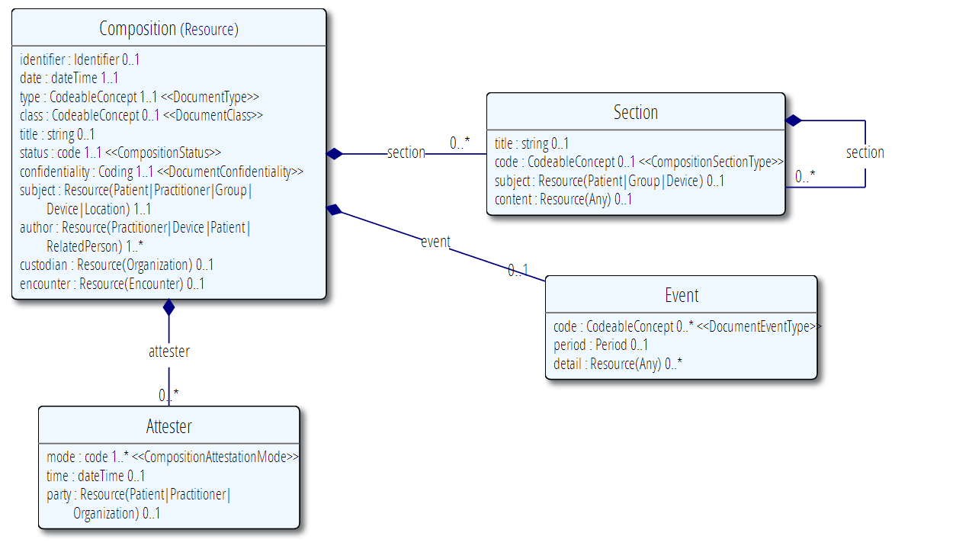
FHIR Document: Composition

Slide 68
FHIR Document
<Feed (Tag = Document)>
<entry id="http://acme.com/Composition/5">
<Composition>
<subject reference="http://acme.com/Patient/1"/> <section title="Vital Signs">
<content reference="http://acme.com/List/1"/> </section>
</Composition>
<Patient id="http://acme.com/Patient/1"/>
<Observation id="http://acme.com/Observation/1"/>
<List id="http://acme.com/List/1">
<contained>
<Observation id="obs2"/>
</contained>
<item reference="http://acme.com/Observation/1"/>
<item reference=“#obs2"/>
</List>
</Feed>

Slide 69
Implementation

Slide 70
Implementation Contexts
Standalone FHIR Server
A FHIR Server in front of an existing application (e.g. SQL)
FHIR as front end to an XDS server (“MHD”)
An interface engine that ‘speaks’ FHIR
A tablet/mobile phone application
A web portal that uses FHIR to access other systems
A healthcare application that access information from multiple systems as well as it’s own server
Smart-On-FHIR – an EHR plug-in framework

Slide 71
Implementation Assistance
Reference Implementations – object models, parsers, serializers, clients, validators, utilities
C#, Java, Delphi, ObjectiveC
Javascript, XMLTools
Schema, Schematron, Validation Pack
1000’s of examples
Live Servers to test against
http://wiki.hl7.org/index.php?title=Publicly_Available_FHIR_Servers_for_testing
Connectathons

Slide 72
Servers
Use the servers to explore how it works
We’ve already done that
Upload your patient resource now!
Write clients that use the test data
Test that you got your own system right
Most developers:
use the servers to learn
consult the documentation occasionally
I do recommend to read the specification a little

Slide 73
Other Free software
See http://wiki.hl7.org/index.php?title=Open_Source_FHIR_implementations
Coming shortly:
“Sprinkler” – a conformance test tool for servers
“Forge” – an editor for conformance statements
A Value set Editor
Several implementation guide publisher
Lantana working on this

Slide 74
Connectathons
Open invitation to any interested party to come and write software that exchanges FHIR resources
Always hold one before HL7 meetings (last week)
Others by invitation (this week!)
4-5 more in the works for this year
Mix of skills
Newbies (“where is the spec?”)
Old hands who’ve been to every connectathon
Experiment with new features
We have a virtual connectathon all the time…

Slide 75
Implementation Assistance
Stack Overflow – ask implementation questions
Link from front page
Search for answers first
Don’t ask for changes to the spec (get deleted!)
gForge Tracker – ask for changes to the spec
Link from bottom of every page
But have discussion somewhere first
Disqus – on every page of the specification
Skype – implementers channel – 105 participants
FHIR Email list, Connectathons, Tutorials

Slide 76
CCDA and FHIR

Slide 77
FHIR vs CDA
Each section corresponds to a resource
But give each section it’s own identity (must persist)
Use XHTML instead of CDA narrative
Simplify the data definitions (more direct)
Break up the header into resources
Bundle the resources up into a single XML document using Atom
Rendering is a little simpler than for CDA

